Slide 1
Group 4: Double-panel system
ME613: Advanced Engineering Acoustics
Homework 3a Presentation
Apr. 4, 2022
Ben Masters, Senior in Acoustical Engineering
Eunseob Kim, Ph.D. Candidate in Mechanical Engineering
Jinghe Yu, M.S. Student in Mechanical Engineering

Slide 2




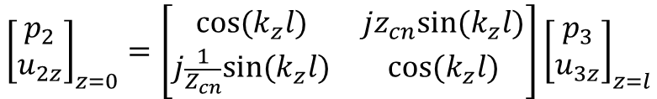






Analytical expression: Transfer matrix
Medium: Air
Two panels: homogeneous and limp
x
Transfer matrix for a panel, $\left[T_{1}\right]$
p₁
p₂
x
$${\left[\begin{matrix}p_{1} \\ u_{1z}\end{matrix}\right]}_{z=0^{−}}=\left[\begin{matrix}1 & z_{m} \\ 0 & 1\end{matrix}\right]{\left[\begin{matrix}p_{2} \\ u_{2z}\end{matrix}\right]}_{z=0^{+}}$$
where $z_{m}=jωm_{s}$
m_{s1}
m_{s2}
u_{1z}
u_{2z}
R
p₁
p₂
p₃
p₄
z
u_{1z}
u_{2z}
u_{3z}
u_{4z}
T
Transfer matrix for airspace, $\left[T_{A}\right]$
R’
T’
x
θ
θ
θ
θ
p₂
p₃
$${\left[\begin{matrix}p_{2} \\ u_{2z}\end{matrix}\right]}_{z=0}=\left[\begin{matrix}cos⁡(k_{z}l) & jz_{cn}sin⁡(k_{z}l) \\ j\frac{1}{Z_{cn}}sin⁡(k_{z}l) & cos⁡(k_{z}l)\end{matrix}\right]{\left[\begin{matrix}p_{3} \\ u_{3z}\end{matrix}\right]}_{z=l}$$
z
u_{2z}
u_{3z}
θ
z
$$TL=10\log_{10}\frac{1}{{\left|T\right|}^{2}}$$
l
where $Z_{cn}=\frac{ρ_{0}c}{cosθ}$
l
1
k_{z}=kcosθ
Nomenclature
ρ₀: Air density
c: Sound speed
ω: Frequency
k: wavenumber
[T]: Transfer function
m_{s}: Mass per unit area
z_{m}: in vacuo mechanical impedance
Z_{cn}: Characteristic impedance referred to θ direction
p: Pressure
u: Particle velocity
R: Reflection coefficient
T: Transmission coefficient
θ: Angle of incidence
l: depth of airspace between panels
TL: Transmission loss
z=0
z=l
$$\left[T_{1}\right]$$
$$\left[T_{A}\right]$$
$$\left[T_{2}\right]$$
Panel 1
Airspace
Panel 2
$$\left[T_{t}\right]=\left[T_{1}\right]\left[T_{A}\right]\left[T_{2}\right]$$
Total (system)

Slide 3
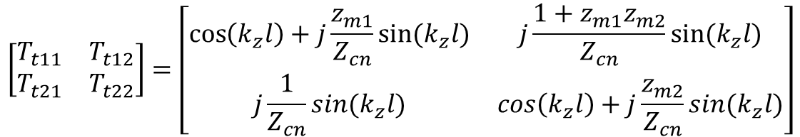

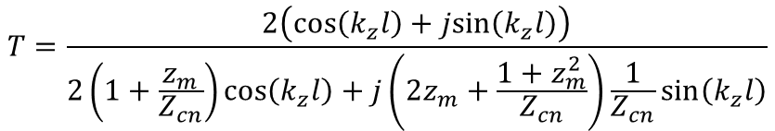
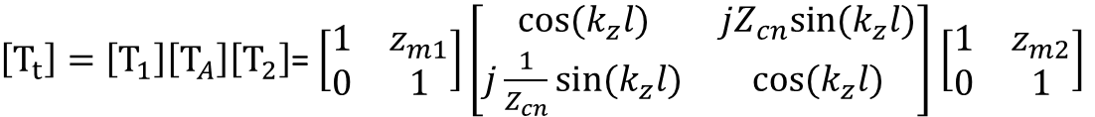
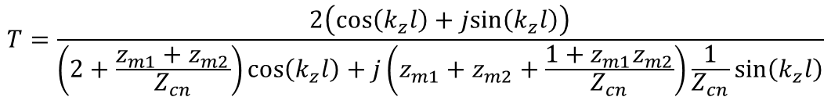
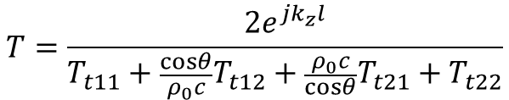
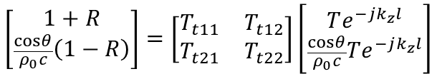

Analytical expression: Transmission coefficient
$${\left[\begin{matrix}p_{1} \\ u_{1z}\end{matrix}\right]}_{z=0}=\left[T_{t}\right]{\left[\begin{matrix}p_{4} \\ u_{4z}\end{matrix}\right]}_{z=l}$$
$\left[T_{t}\right]=\left[T_{1}\right]\left[T_{A}\right]\left[T_{2}\right]$= $\left[\begin{matrix}1 & z_{m1} \\ 0 & 1\end{matrix}\right]\left[\begin{matrix}cos⁡(k_{z}l) & jZ_{cn}sin⁡(k_{z}l) \\ j\frac{1}{Z_{cn}}sin⁡(k_{z}l) & cos⁡(k_{z}l)\end{matrix}\right]$ $\left[\begin{matrix}1 & z_{m2} \\ 0 & 1\end{matrix}\right]$
…(1)
$$\left[\begin{matrix}1+R \\ \frac{cosθ}{ρ_{0}c}\left(1−R\right)\end{matrix}\right]=\left[\begin{matrix}T_{t11} & T_{t12} \\ T_{t21} & T_{t22}\end{matrix}\right]\left[\begin{matrix}Te^{−jk_{z}l} \\ \frac{cosθ}{ρ_{0}c}Te^{−jk_{z}l}\end{matrix}\right]$$
$$\left[\begin{matrix}T_{t11} & T_{t12} \\ T_{t21} & T_{t22}\end{matrix}\right]=\left[\begin{matrix}\cos\left(k_{z}l\right)+j\frac{z_{m1}}{Z_{cn}}sin⁡(k_{z}l) & j\frac{1+z_{m1}z_{m2}}{Z_{cn}}sin⁡(k_{z}l) \\ j\frac{1}{Z_{cn}}sin⁡(k_{z}l) & \cos\left(k_{z}l\right)+j\frac{z_{m2}}{Z_{cn}}sin⁡(k_{z}l)\end{matrix}\right]$$
…(3)
$$T=\frac{2e^{jk_{z}l}}{T_{t11}+\frac{cosθ}{ρ_{0}c}T_{t12}+\frac{ρ_{0}c}{cosθ}T_{t21}+T_{t22}}$$
…(2)
where z_{mi} = jωm_{si} and $Z_{cn}=\frac{ρ_{0}c}{cosθ}$
Two identical Aluminum panels
$$T=\frac{2\left(cos\left(k_{z}l\right)+jsin\left(k_{z}l\right)\right)}{\left(2+\frac{z_{m1}+z_{m2}}{Z_{cn}}\right)cos\left(k_{z}l\right)+j\left(z_{m1}+z_{m2}+\frac{1+z_{m1}z_{m2}}{Z_{cn}}\right)\frac{1}{Z_{cn}}sin\left(k_{z}l\right)}$$
x
m_{s}
p₁
p₄
R
u_{1z}
u_{4z}
T
Constant
ρ₀ = 1.21 kg/m³
c = 340 m/s
ρ_{AL} = 2719 kg/m³
d = 1 mm
l = 100 mm
m_{s}= ρ_{AL}d = 2.710 kg/m³
If two panels are identical (z_{m1}=z_{m2}= z_{m} =jωm_{s}),
θ
θ
θ
z
$$T=\frac{2\left(cos\left(k_{z}l\right)+jsin\left(k_{z}l\right)\right)}{2\left(1+\frac{z_{m}}{Z_{cn}}\right)cos\left(k_{z}l\right)+j\left(2z_{m}+\frac{1+z_{m}^{2}}{Z_{cn}}\right)\frac{1}{Z_{cn}}sin\left(k_{z}l\right)}$$
1
d
l
d
z=0
z=100 mm

Slide 4
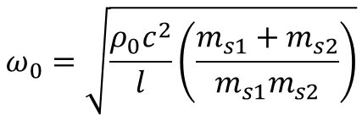
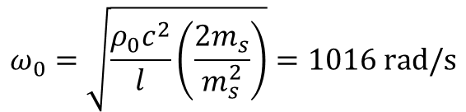
i) Normal incidence transmission loss
Stiffness line (18 dB/oct)
Mass line
(6 dB/oct)
Transmission Loss goes to 0 at the Mass-Air-Mass Resonance.
Other Notable Characteristics:
6 dB/oct ‘Mass Line’ below resonance
18 dB/oct ‘Stiffness Line’ above resonance
ω₀=1016 rad/s
Mass – Air – Mass
$$ω_{0}=\sqrt{\frac{ρ_{0}c^{2}}{l}\left(\frac{m_{s1}+m_{s2}}{m_{s1}m_{s2}}\right)}$$
Stiffness line
(18 dB/oct)
m_{s1}
m_{s1}
Mass line
(6 dB/oct)
Two identical Aluminum panels
m_{s}
m_{s}
$$ω_{0}=\sqrt{\frac{ρ_{0}c^{2}}{l}\left(\frac{2m_{s}}{m_{s}^{2}}\right)}=1016 rad/s$$
Transmission Loss of Double Panel System

Slide 5


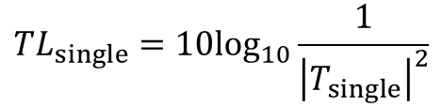
ii) Comparison with approximation
The approximation line falls near the peaks of the double panel system.
Good approximation of TL above M-A-M resonance.
Important to keep in mind the ‘peak and dip’ phenomena at high frequencies
x
m_{s}
$${TL}_{double}={TL}_{single}+{TL}_{single}+6 dB$$
R
T_{single}
θ
θ
$$T_{single}=\frac{2ρ_{0}csecθ}{2ρ_{0}csecθ+z_{m} }$$
θ
z
d
$${TL}_{single}=10\log_{10}\frac{1}{{\left|T_{single}\right|}^{2}}$$
1
z=0
Single panel case
Double Panel vs. Approximation

Slide 6

iii) Single panel comparison
Single panel with a mass per unit area equal to the double panels.
TL is equal before the M-A-M effect begins.
$$m_{s, single}=2m_{s}$$
x
m_{s}
x
T_{double}
m_{s,single}
R
R
T_{single}
θ
Airspace
θ
θ
θ
θ
z
z
θ
d
l
d
2d
1
1
z=0
z=l
z=0
Double-panel system
Single panel system
(no airspace)
Double Panel vs. Single Panel

Slide 7

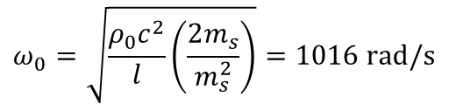
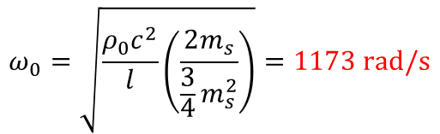
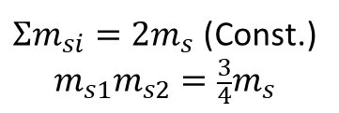

iv) Effect of mass distribution of panel
Changing the mass distribution to 3:1, i.e. thickness of the two panels is changed to 1.5 mm and 0.5 mm.
$$m_{s1}=\frac{m_{s}}{2}$$
$$m_{s2}=\frac{3m_{s}}{2}$$
$Σm_{si}=2m_{s}$ (Const.)
$$m_{s1}m_{s2}=\frac{3}{4}m_{s}$$
Assume
and
→
ω₀=1173 rad/s
m_{s}
m_{s}
m_{s1}
m_{s2}
ω₀=1016 rad/s
d
d
1.5d
0.5d
Original system
New system
$$ω_{0}=\sqrt{\frac{ρ_{0}c^{2}}{l}\left(\frac{2m_{s}}{m_{s}^{2}}\right)}=1016 rad/s$$
$$ω_{0}=\sqrt{\frac{ρ_{0}c^{2}}{l}\left(\frac{2m_{s}}{\frac{3}{4}m_{s}^{2}}\right)}=1173 rad/s$$
Mass-air-mass resonance frequency increases
Transmission loss is not zero at this point.
Transmission Loss and M-A-M Resonance

Slide 8
v) Effect of ratio of l to λ on peaks and dips
The figure of transmission loss versus (airspace depth / wavelength) is plotted. The x-axis is in linear but not log scale:
Dips appear when airspace depth equals to n/2 wavelength.
Peaks appear between every two dips, that is when depth equals to (2n+1)/4 wavelength
The minima of dips are close to a mass line at very high frequency, but for the first several dips, they are not exactly on a mass line.

Slide 9
vi) Effect of incidence angle (θ) on transmission loss
Increasing the angle of incidence
x
x
x
θ=0°
p_{i}
z
θ
z
θ
z
p_{i}
p_{i}
Normal incidence
θ=30°
θ=60°
Normal, 30 degree, and 60 degree incidence cases are plotted.
It can be found the mass-air-mass resonance, dips and peaks all move to higher frequencies when incidence angle increases.

Slide 10
Thank you for your attention!
Role
Eunseob Kim: Modeling and analytical solution
Ben Masters: MATLAB coding and solving i), ii), and iii)
Jinghe Yu: MATLAB coding and solving iv), v), and vi)

